Slide 1

Optimising Spark for Large-Scale Data Processing

Slide 2


Course: Data Engineering - II
Lecture On: Optimising Disk I/O for Spark
Instructor: Vishwa Mohan

Slide 3
EMR CLUSTER AT A GLANCE
Elastic MapReduce
A ready-made setup for big data tools
Expandable low configuration service
Amazon EMR is a managed cluster platform that simplifies running big data frameworks, such as Apache Hadoop and Apache Spark, on AWS to process and analyse vast amounts of data.
EMR Cluster
Dynamic resizing
Based on Hadoop

Slide 4
EMR CLUSTER
Advantage
Disadvantage
Provides automatic scaling and ensures minimal loss of HDFS data and low costs, as spot instances can be used
Has no management console similar to that of Cloudera Manager, which makes it difficult to manage and monitor services
Enables dynamic orchestration of a new cluster on-demand and easy termination once the work is done to optimise costs
Does not ensure high availability of the cluster’s master node, which makes it a single point of failure
Enables direct access to data on S3 from or through Hive tables
Does not allow shutting down of the clusters and is restricted to being directly terminated
Enables highly availability of slave nodes due to constant monitoring and replaces unhealthy nodes with new nodes
Although automatic replacement of unhealthy nodes offers a maintenance advantage, this poses a risk of data loss

Slide 5
COMPONENTS OF A SPARK JOB
Application
Job
It is the main function, where the code is present.
It is the work submitted, which is created when an action is called.
Spark
Job
Task
Stages
Each stage consists of multiple tasks. It is the smallest unit of work.
A job contains multiple stages. Each time a shuffle happens, a new stage is created.

Slide 6
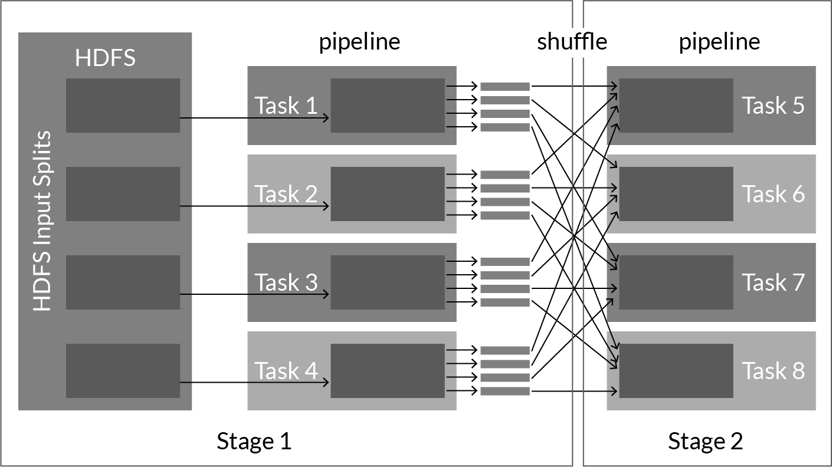
COMPONENTS OF A SPARK JOB

Slide 7
WHY OPTIMISE A SPARK JOB?
01
From the execution time perspective
02
From the resource utilisation perspective
03
From the scalability point of view
04
From the maintainability point of view

Slide 8
KEY PERFORMANCE METRICS IN A SPARK JOB
01
Stages and tasks
02
RDD - memory imprint and usage
03
Spark environment information
04
Detailed information about running executors

Slide 9
JOB OPTIMISATION
Code-Level Optimisation
Cluster-Level Optimisation
For example, deciding on the right number of partitions and the partitioning size for the entire data set, which APIs to use to handle the data, which methods to use.
For example, deciding on the number of machines, how to optimise the utilisation of a cluster, how to prevent underutilisation.

Slide 10
CODE OPTIMISATION
01
Reduce Disk I/O
02
Reduce Network I/O

Slide 11
REDUCING DISK I/O
01
Proper serialisation
02
Memory tuning
03
Storing data in more optimised file formats
04
Using a caching strategy

Slide 12
REDUCING NETWORK I/O
01
Data locality
02
Partitioning
03
Shuffle and sort
04
Joins

Slide 13
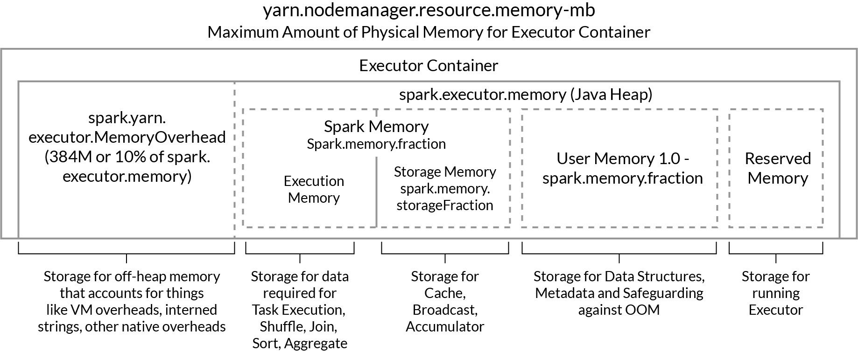
CLUSTER OPTIMISATION

Slide 14



UNDERSTANDING DISK I/O IN SPARK
Disk I/O
Reading/Writing data from hard disks
Seek Delay
Rotational Delay of Hard Disks
Transfer Delay
Total Delay = Seek Delay + Rotational Delay of HDD + Transfer Delay

Slide 15
TECHNIQUES TO REDUCE DISK I/O
Q1
Avoid shuffling as much as possible
Shuffling leads to stages. At the stage boundary, data is stored in the disk to be fault-tolerant
A:
Q2
File formats: Parquet and ORC
Compress the size by close to 70%, which leads to less storage, and use columnar storage for better compression
A:
Q3
Serialisation and deserialisation
Uses serialised memory storage and cached data in a serialised form using the Kryo algorithm
A:

Slide 16
USING VARIOUS FILE FORMATS IN SPARK
01
.txt
02
.csv
Parquet
05
.json
03
ORC
06
.avro
04

Slide 17
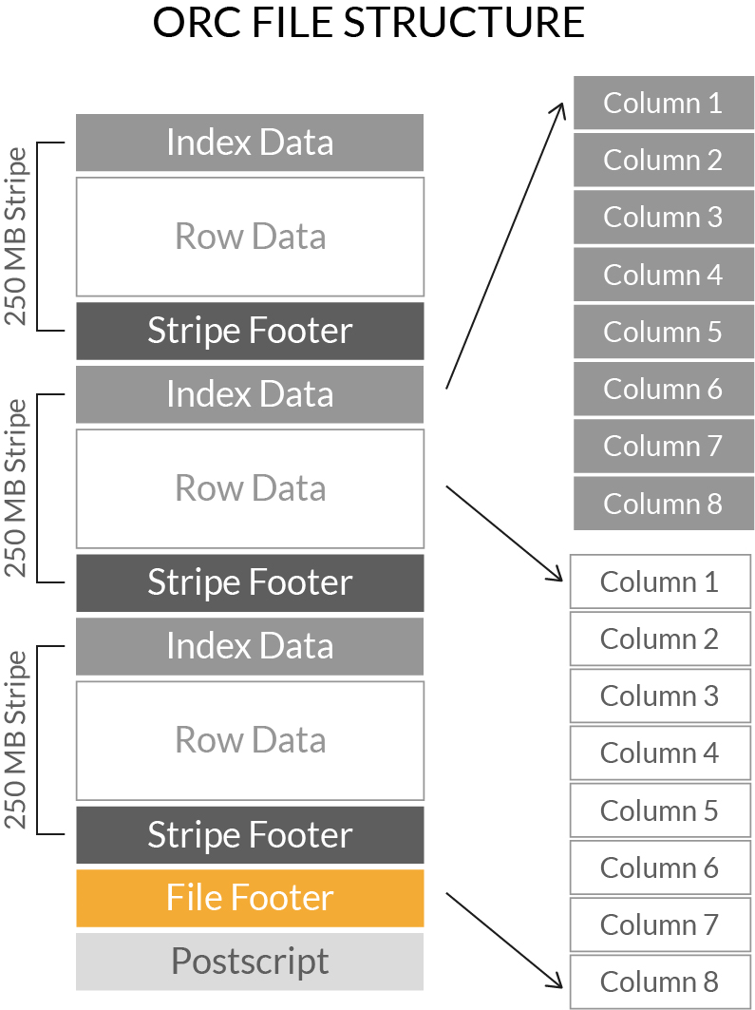
ORC FILE FORMAT
Used for both compressed and uncompressed storage
Stores a collection of rows in a file, and within a collection, it stores row data in a columnar format
Fast response time
Better when the original data is flat
Supports light weight index

Slide 18
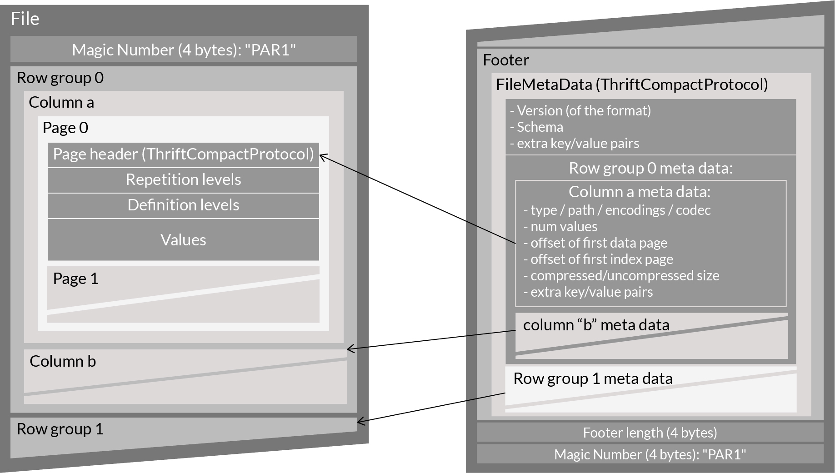
PARQUET FILE FORMAT
Columnar storage - efficient compression storage
Metadata at the end of the file
Supported by all Apache big data products
Used in the case of nested data

Slide 19
IMPACT OF CHOOSING A FILE FORMAT
01
Faster read time
02
Faster write time
03
Splittable files
Advanced compression support
05
Schema evolution support
04

Slide 20
BENEFITS OF USING A COLUMNAR FILE FORMAT
01
Better compression, as the data is more homogenous
02
I/O will be reduced, as you will scan only a subset of a column
03
You can use an encoding better suited to modern processors (as the data in a column is of the same type).

Slide 21
WHAT IS SERIALISATION?
Serialisation: A mechanism to convert the state of an object to a byte stream
Deserialisation: The process of converting a byte stream to an object is known as deserialisation.
Marshal Serialiser
Pickle Serialiser

Slide 22
WHY SERIALISATION?
Serialisation is implemented for maintaining performance in distributed systems.
Serialisation is helpful when you want to save objects to a disk or send them over networks.
For example, RDDs may be serialised to:
Decrease memory usage when stored in a serialised form
Reduce network bottleneck in processes such as shuffling
Tune Performance
Another example is that objects can be serialised so they can be sent to the Spark worker nodes.

Slide 23
SERIALISERS ARE SET DURING THE CREATION OF SPARKCONTEXT.
Marshal Serialiser
Pickle Serialiser
Faster
Comparatively slower
Supports nearly every Python object type
Supports fewer data types

Slide 24
SPARK MEMORY MANAGEMENT PARAMETERS
MEMORY LEVELS SUPPORTED BY SPARK
01
MEMORY_ONLY
02
MEMORY_AND_DISK
DISK_ONLY
05
MEMORY_ONLY_SER
03
MEMORY_ONLY_2 and MEMORY_AND_DISK_2
06
MEMORY_AND_DISK_SER
04

Slide 25


RDD PERSISTENCE: MEMORY ONLY
Memory
RDD
rdd.persist (MEMORY_ONLY)
Memory

Slide 26

RDD PERSISTENCE: MEMORY & DISK
Memory
RDD
Disk
rdd.persist (MEMORY_AND_DISK)
Memory

Slide 27
RDD PERSISTENCE: MEMORY ONLY SERIALIZED
Memory
RDD
RDD as Serialized Java Object
rdd.persist (MEMORY_ONLY_SER)
Memory

Slide 28
RDD PERSISTENCE: MEMORY & DISK SERIALIZED
RDD as Serialized Java Object
RDD
The excess data goes to disk
Memory
Disk
rdd.persist (MEMORY_AND_DISK_SER)

Slide 29
RDD PERSISTENCE: DISK ONLY
Disk
RDD
rdd.persist (DISK_ONLY)
Disk

Slide 30
SPARK MEMORY MANAGEMENT PARAMETERS
Cache
Persist
Stores the intermediate computation so that it can be reused.

Slide 31
SPARK MEMORY MANAGEMENT PARAMETERS
Cache
Persist
Dataframe - Memory and disk
RDD - Only memory
Lazy operation
Memory levels supported - All levels are supported
Lazy operation

Slide 32
SPARK MEMORY MANAGEMENT PARAMETERS
Checkpoint
Breaks the lineage as compared with Cache and Persist, which maintain the lineage
Computes separately from other jobs
Checkpoint data is persistent and is not removed after SparkContext is destroyed

Slide 33
SPARK MEMORY MANAGEMENT PARAMETERS
Unpersist
Manually (on demand) remove the rdd from the cache
Cache is evicted automatically following LRU eviction principle if not called manually

